Slide 1
Smart Air Purifier
By Md. Masrur Saqib,
Student,
CSE - 18, RUET.

Slide 2
What is smart air purifier?
A purifier which have a filter to purify the air inside a room.
A purifier which can be operated with a smart controlling system.

Slide 3
Why air purifier?
*According to WHO, 9 out of 10 people worldwide breathe polluted air
*WHO estimates that around 7 million people die every year from exposure to fine particles in polluted air *
**According to the business standard, Bangladesh has been named the world's most polluted country for PM2.5 exposure
**Dhaka has emerged as the second most polluted city in the 2019 World Air Quality Report.

Slide 4
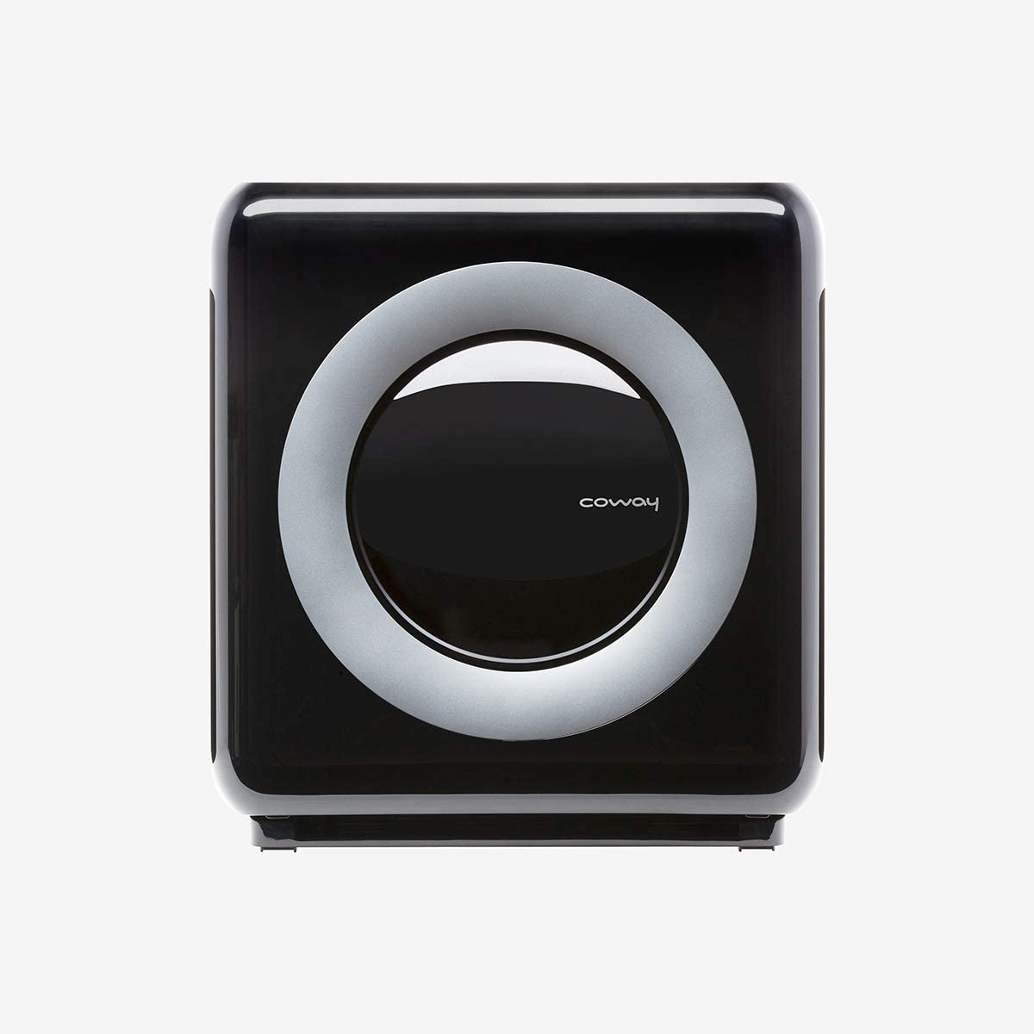
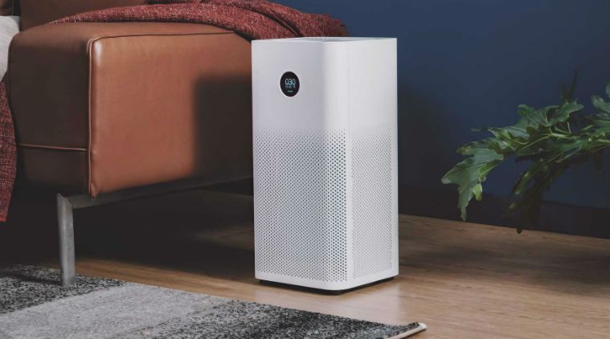
Low cost solution
Price: BDT 15,000
Price:
$249.99 + $954.60 Shipping & Import Fees Deposit to Bangladesh

Slide 5
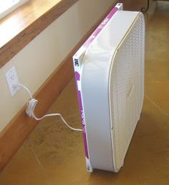
Low cost solution
Box Fan Air purifier
Box Fan = 2800/=
HEPA filter = 1200/=
Total = 4000/=

Slide 6
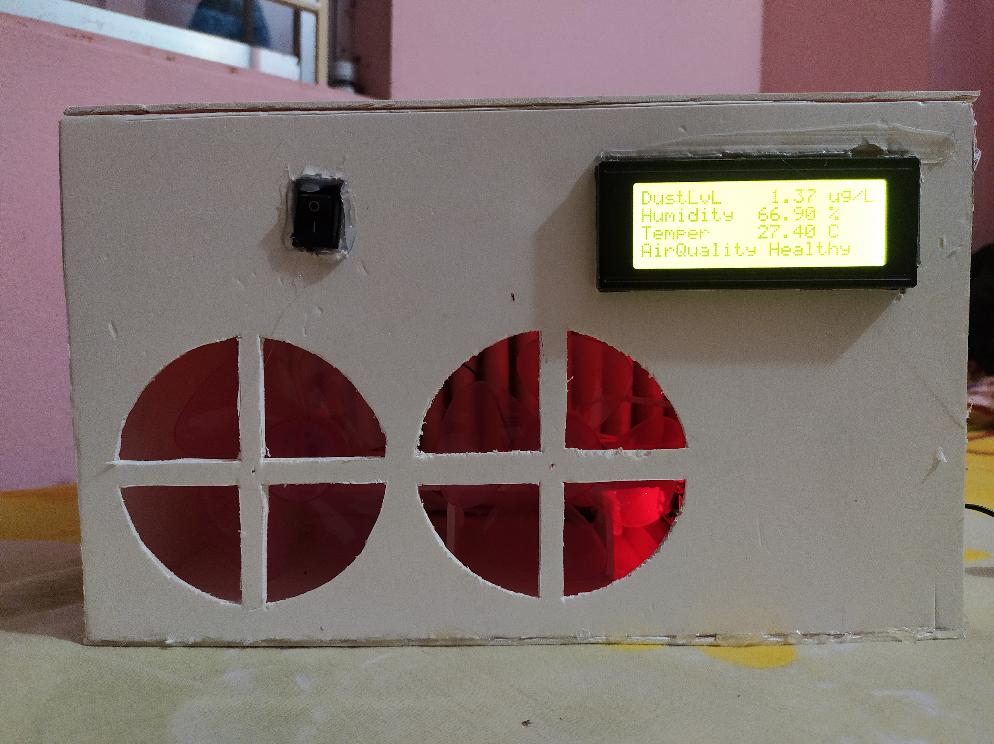
Low cost solution
Cardboard (Body) | 50/=
Filter | 200/=
Fans | 160/=
Adapter | 80/=
Arduino Nano | 250/=
PCB and Others | 100/=
Dust sensor | 600/=
Hum-Temp Sensor | 80/=
LCD | 180/=
Bluetooth | 300/=
Total | 2000/=

Slide 7
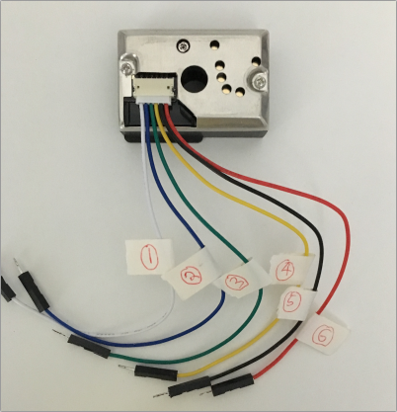
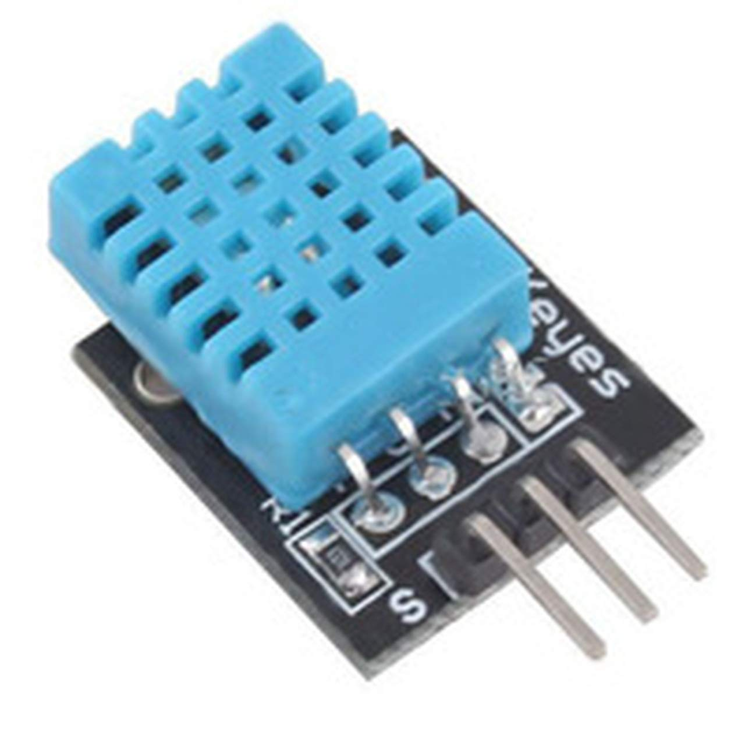
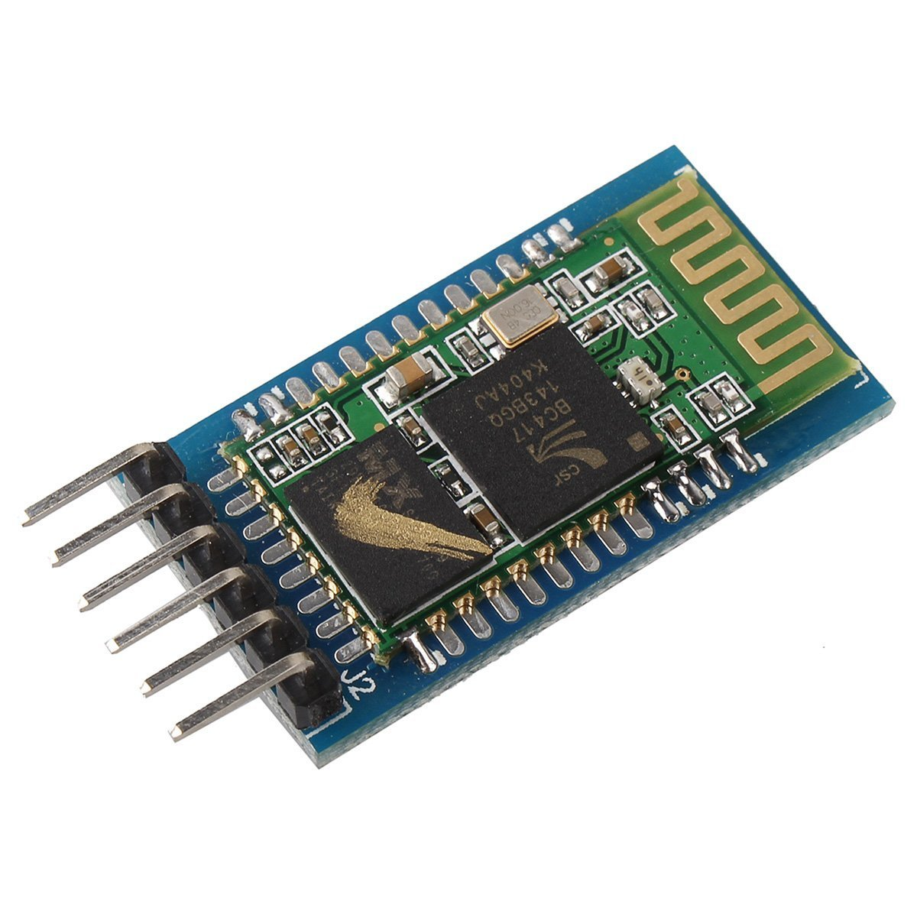
Sensors & Modules
Sharp GP2Y1014AU0F Dust Sensor :: Measures PM2.5
DHT-11 Humidity & Temperature Sensor
HC-05 :: Communication with Android

Slide 8
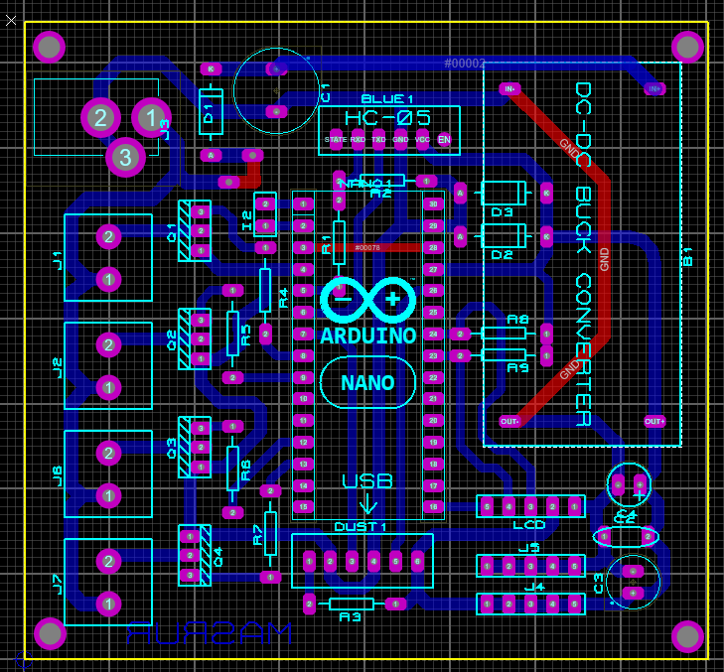
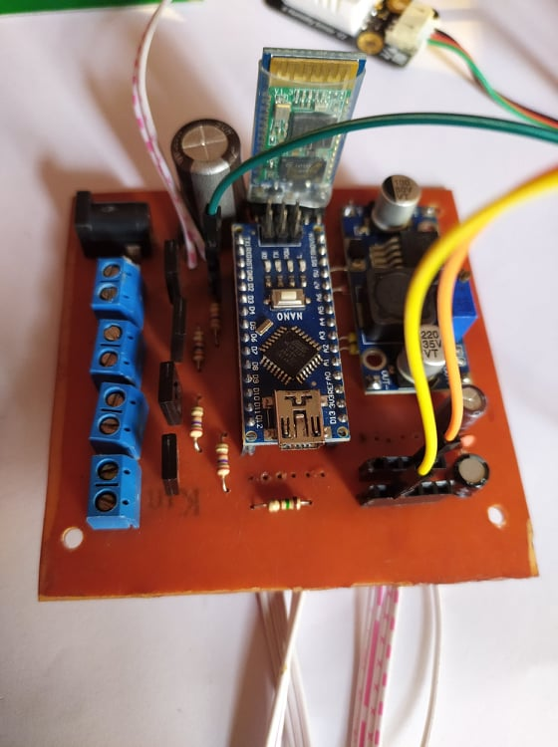
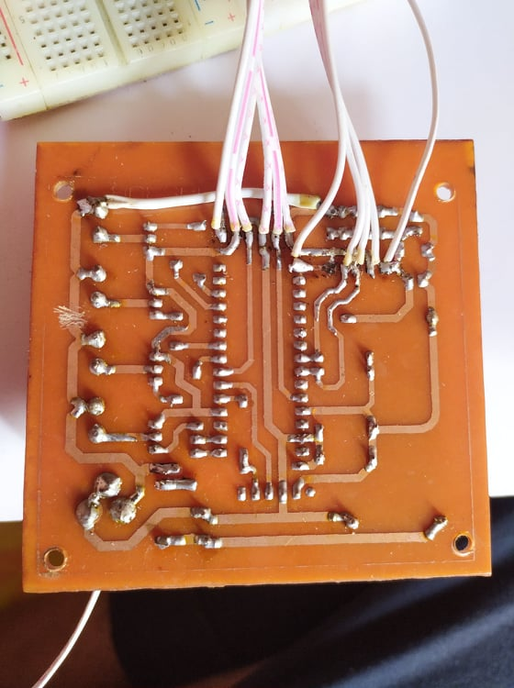
PCB

Slide 9
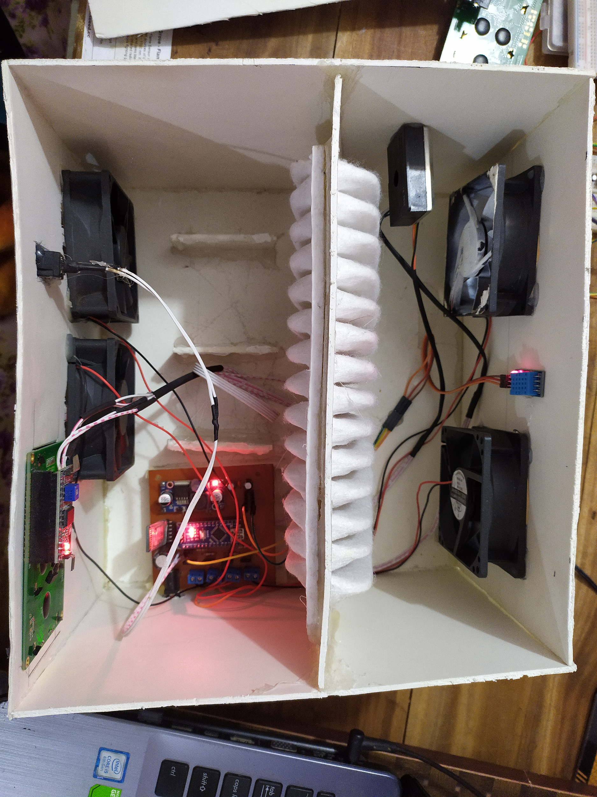
Air Circulation & Sensors Position
Dust Sensor
Hum-Temp Sensor

Slide 10
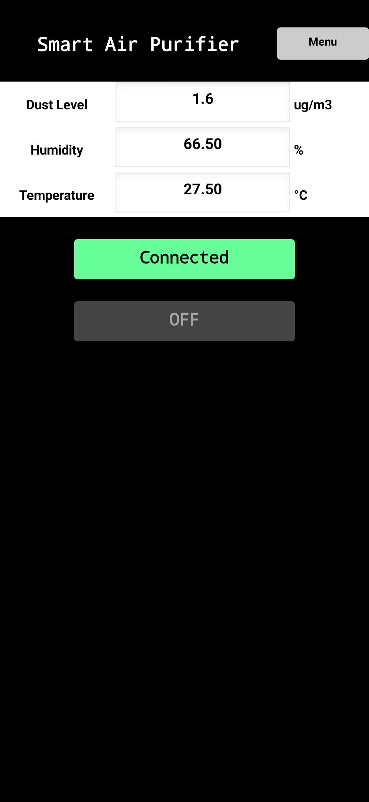
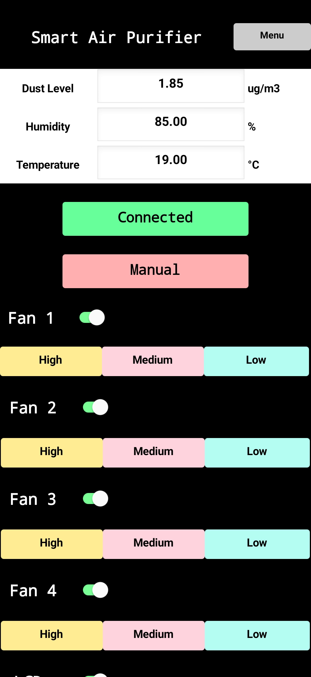
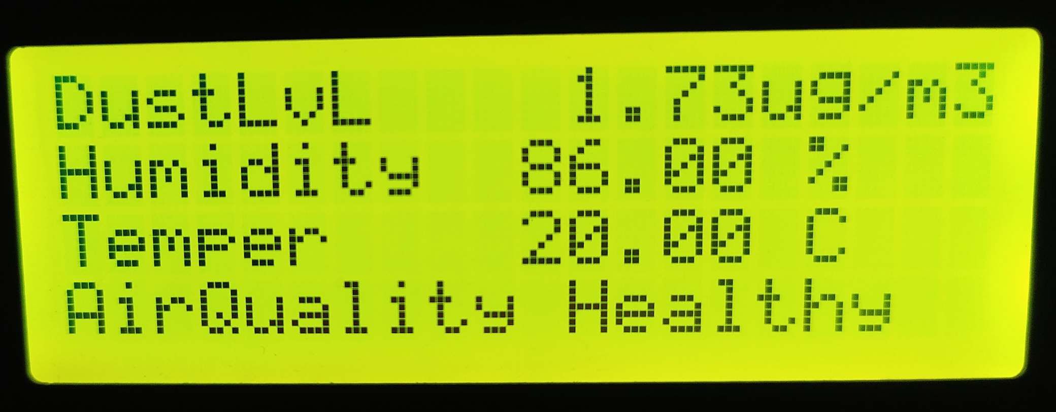
Display, Modes & Android Apps
Air Quality is Based on the measurement of US-AQI
There are 2 modes. Automatic and Manual.
In automatic mode the purifier will run automatically when the air quality is not healthy
The device can be operated manually by the bluetooth connection from an Android device.

Slide 11
Reference Web links
*https://www.who.int/news/item/02-05-2018-9-out-of-10-people-worldwide-breathe-polluted-air-but-more-countries-are-taking-action
**https://tbsnews.net/environment/bangladesh-air-worlds-worst-2019-47959#:~:text=Bangladesh%20air%20world's%20worst%20in%202019,-Among%20the%20world's&text=Bangladesh%20has%20been%20named%20the%20world's%20most%20polluted%20country%20for%20PM2.&text=Being%20among%20the%20world's%20megacities,83.3%20microgrammes%20per%20cubic%20metre.

